Slide 1
Data management and cleaning

Slide 2
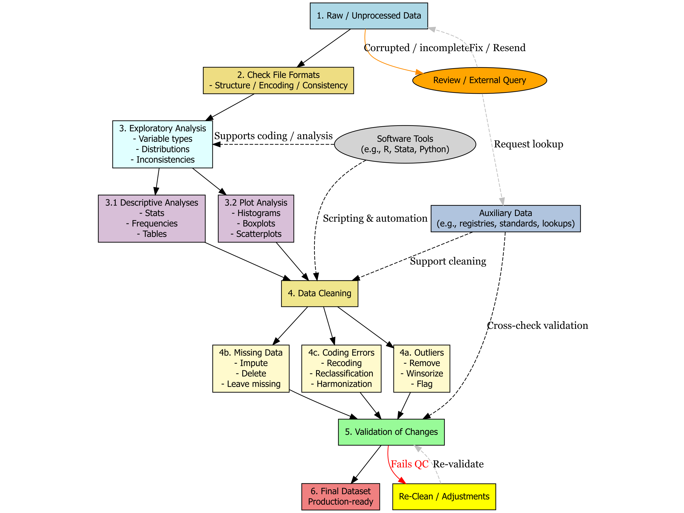

Slide 4
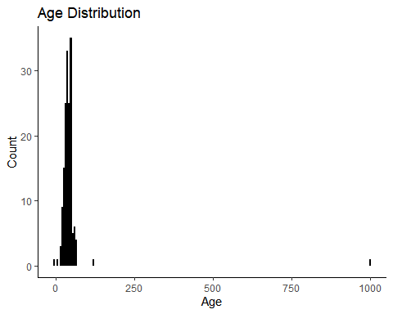
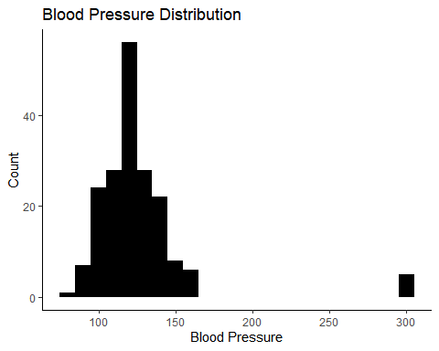
Always plot your data

Slide 5
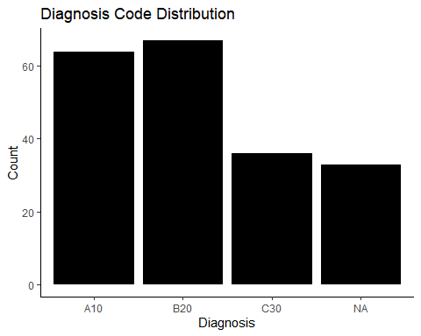
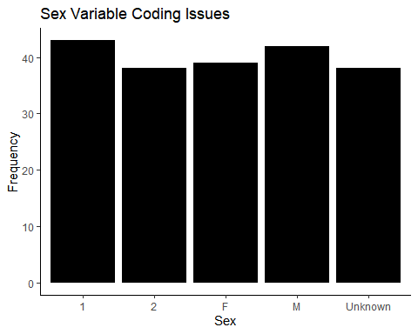
Always plot your data

Slide 6
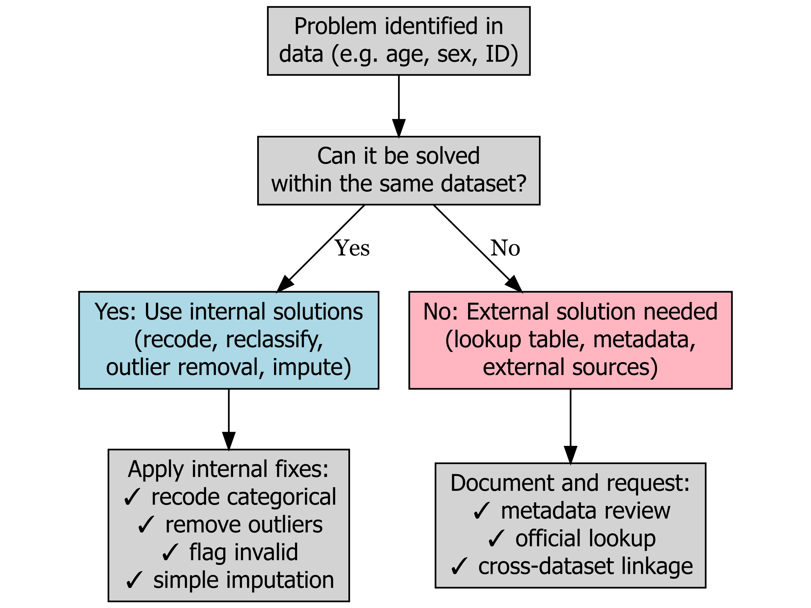
Problems? Data cleaning
Figure 9: Decision making process when problems are identified

Slide 7
Cleaning strategies
Table 12: Summarise of cleaning strategies
Method | Keeps Records | Accurate | Transparent | Use Cases
Drop invalid values | No ❌ | Yes ✅ | Yes ✅ | Strict analyses, validated data
Recode as NA | Yes ✅ | Yes ✅ | Yes ✅ | Flagging issues, imputations
Impute values | Yes ✅ | Maybe ⚠️ | Maybe ⚠️ | Modelling, simulations
Add flag variable | Yes ✅ | Yes ✅ | Yes ✅ | Audits, reproducibility

Slide 8
Method | Description | Keeps_Unknown | Standardizes_All | Use_Case
Recode to labels | Convert 1 → Male, 2 → Female | Yes ✅ | Yes ✅ | Routine harmonization of mixed encodings
Drop Unknown cases | Exclude Unknown from analysis | No ❌ | Yes ✅ | Binary classification tasks, regression
Flag and analyze Unknown separately | Create flag variable: Unknown vs Known | Yes ✅ | Partially ✅ | Audit missing info; adjust models for misclassification
Convert to NA, then impute | Set Unknown as NA, impute based on diagnosis/age | No ❌ | Yes ✅ | Small datasets needing complete covariates
Leave as-is with caution | Use raw labels (risk of errors) | Yes ✅ | No ❌ | Not recommended unless exploratory only

Slide 9
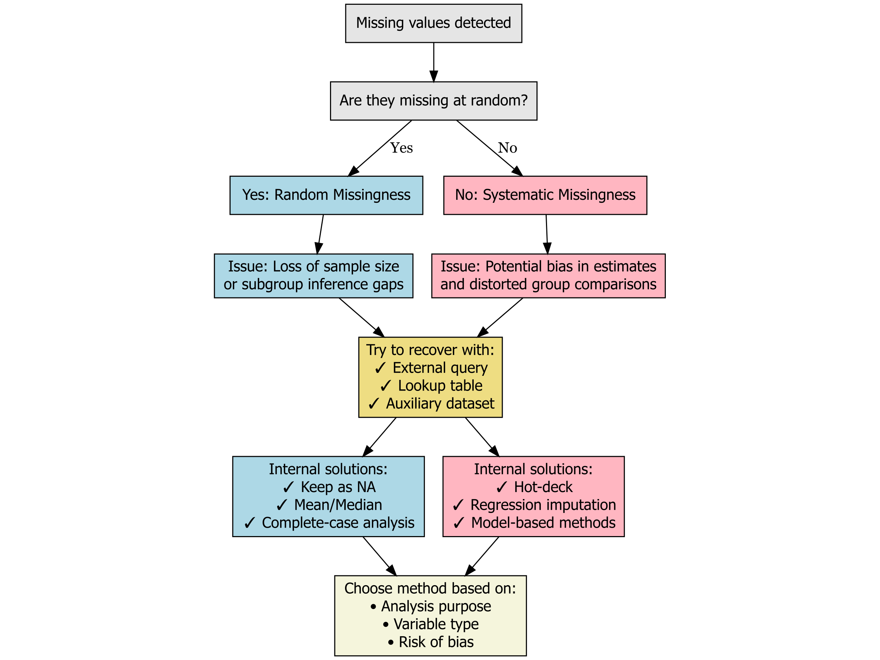
Advanced solutions: Imputation
Figure 10: Missing data management

Slide 10
Changing variables and recoding
Let’s say that I want to recode cases that are above 100 years for the age variable in the data set D
Approach 1: Using the function ifelse()
D$age<-ifelse(D$age>=100,NA,D$age)
Create/change the variable D$age
If D$age is higher or equal to 100
Make it missing
If not (else) leave it as it is

Slide 11
With dplyr and case_when()
D <- D %>%
mutate(age = case_when(age >= 100 ~ NA_real_, TRUE ~ age ))
Change
For my data D
When age is equal or higher than 100, make it missing, if not leave it as it is

Slide 12
Changing variables and recoding
Let’s say that I want to recode cases badly coded cases of gender in the data set D
Approach 1: Using the function ifelse()
D$gender<-ifelse(D$gender==“Man”,”Male”,D$gender)
Create/change the variable D$gender
If D$gender is equal to Man
Make it “Male”
If not (else) leave it as it is

Slide 13
Creating categories from age groups
We have: D$age
Let’s say we want to group by 0-15,16-44,45-64,64+
D <- D %>%
mutate(age_group = case_when(
age >= 0 & age <= 15 ~ "0-15",
age >= 16 & age <= 44 ~ "16-44",
age >= 45 & age <= 64 ~ "45-64",
age >= 65 ~ "65+",
TRUE ~ NA_character_
))
Change my variable
Conditionals
If there are missing do nothing and leave them as they are

Slide 14
Exercise
Using the health_dataexample
Recode al the Unknown cases in health_dataexample as “Females”
Tabulate the proportion of Males and Females using freq()
Recode all the regions 9999 as 101
Tabulate the proportion of regions using freq()
Create age groups: 0-20, 21-30, 31-40,41-50,50+
Tabulate the proportion of groups

